Slide 1
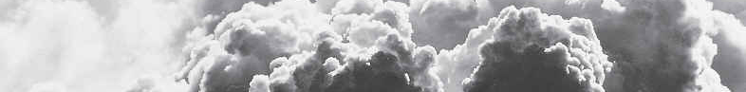
Smoke Tools Workshop
Trent Wickman
trent.wickman@usda.gov
(218) 341-8646

Slide 2
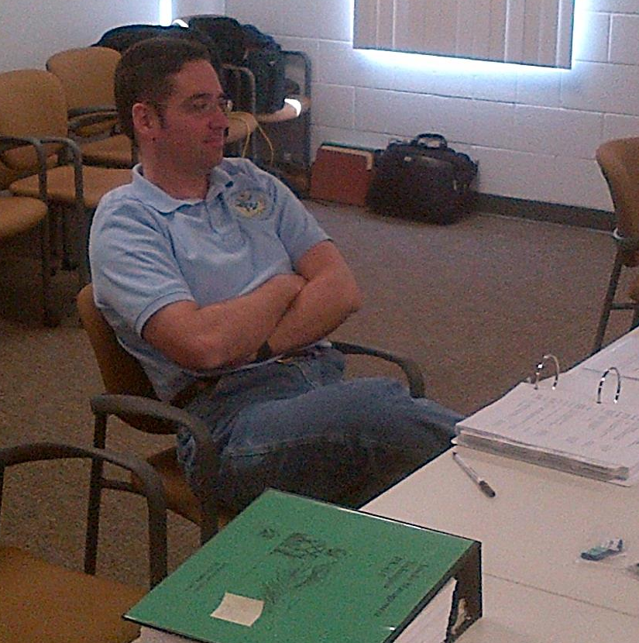
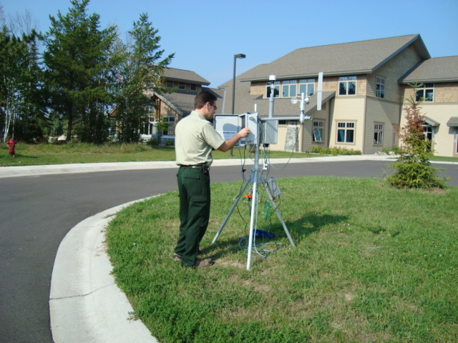


Who am I?
Native of NE MN and UP of MI
Attended Michigan Tech U
Worked for the State of MN for 5 years as an air permit engineer
Been with Forest Service since 2001
2009 – duties expanded to all the Lake States Forests
2014 – Began doing ARA details

Slide 3
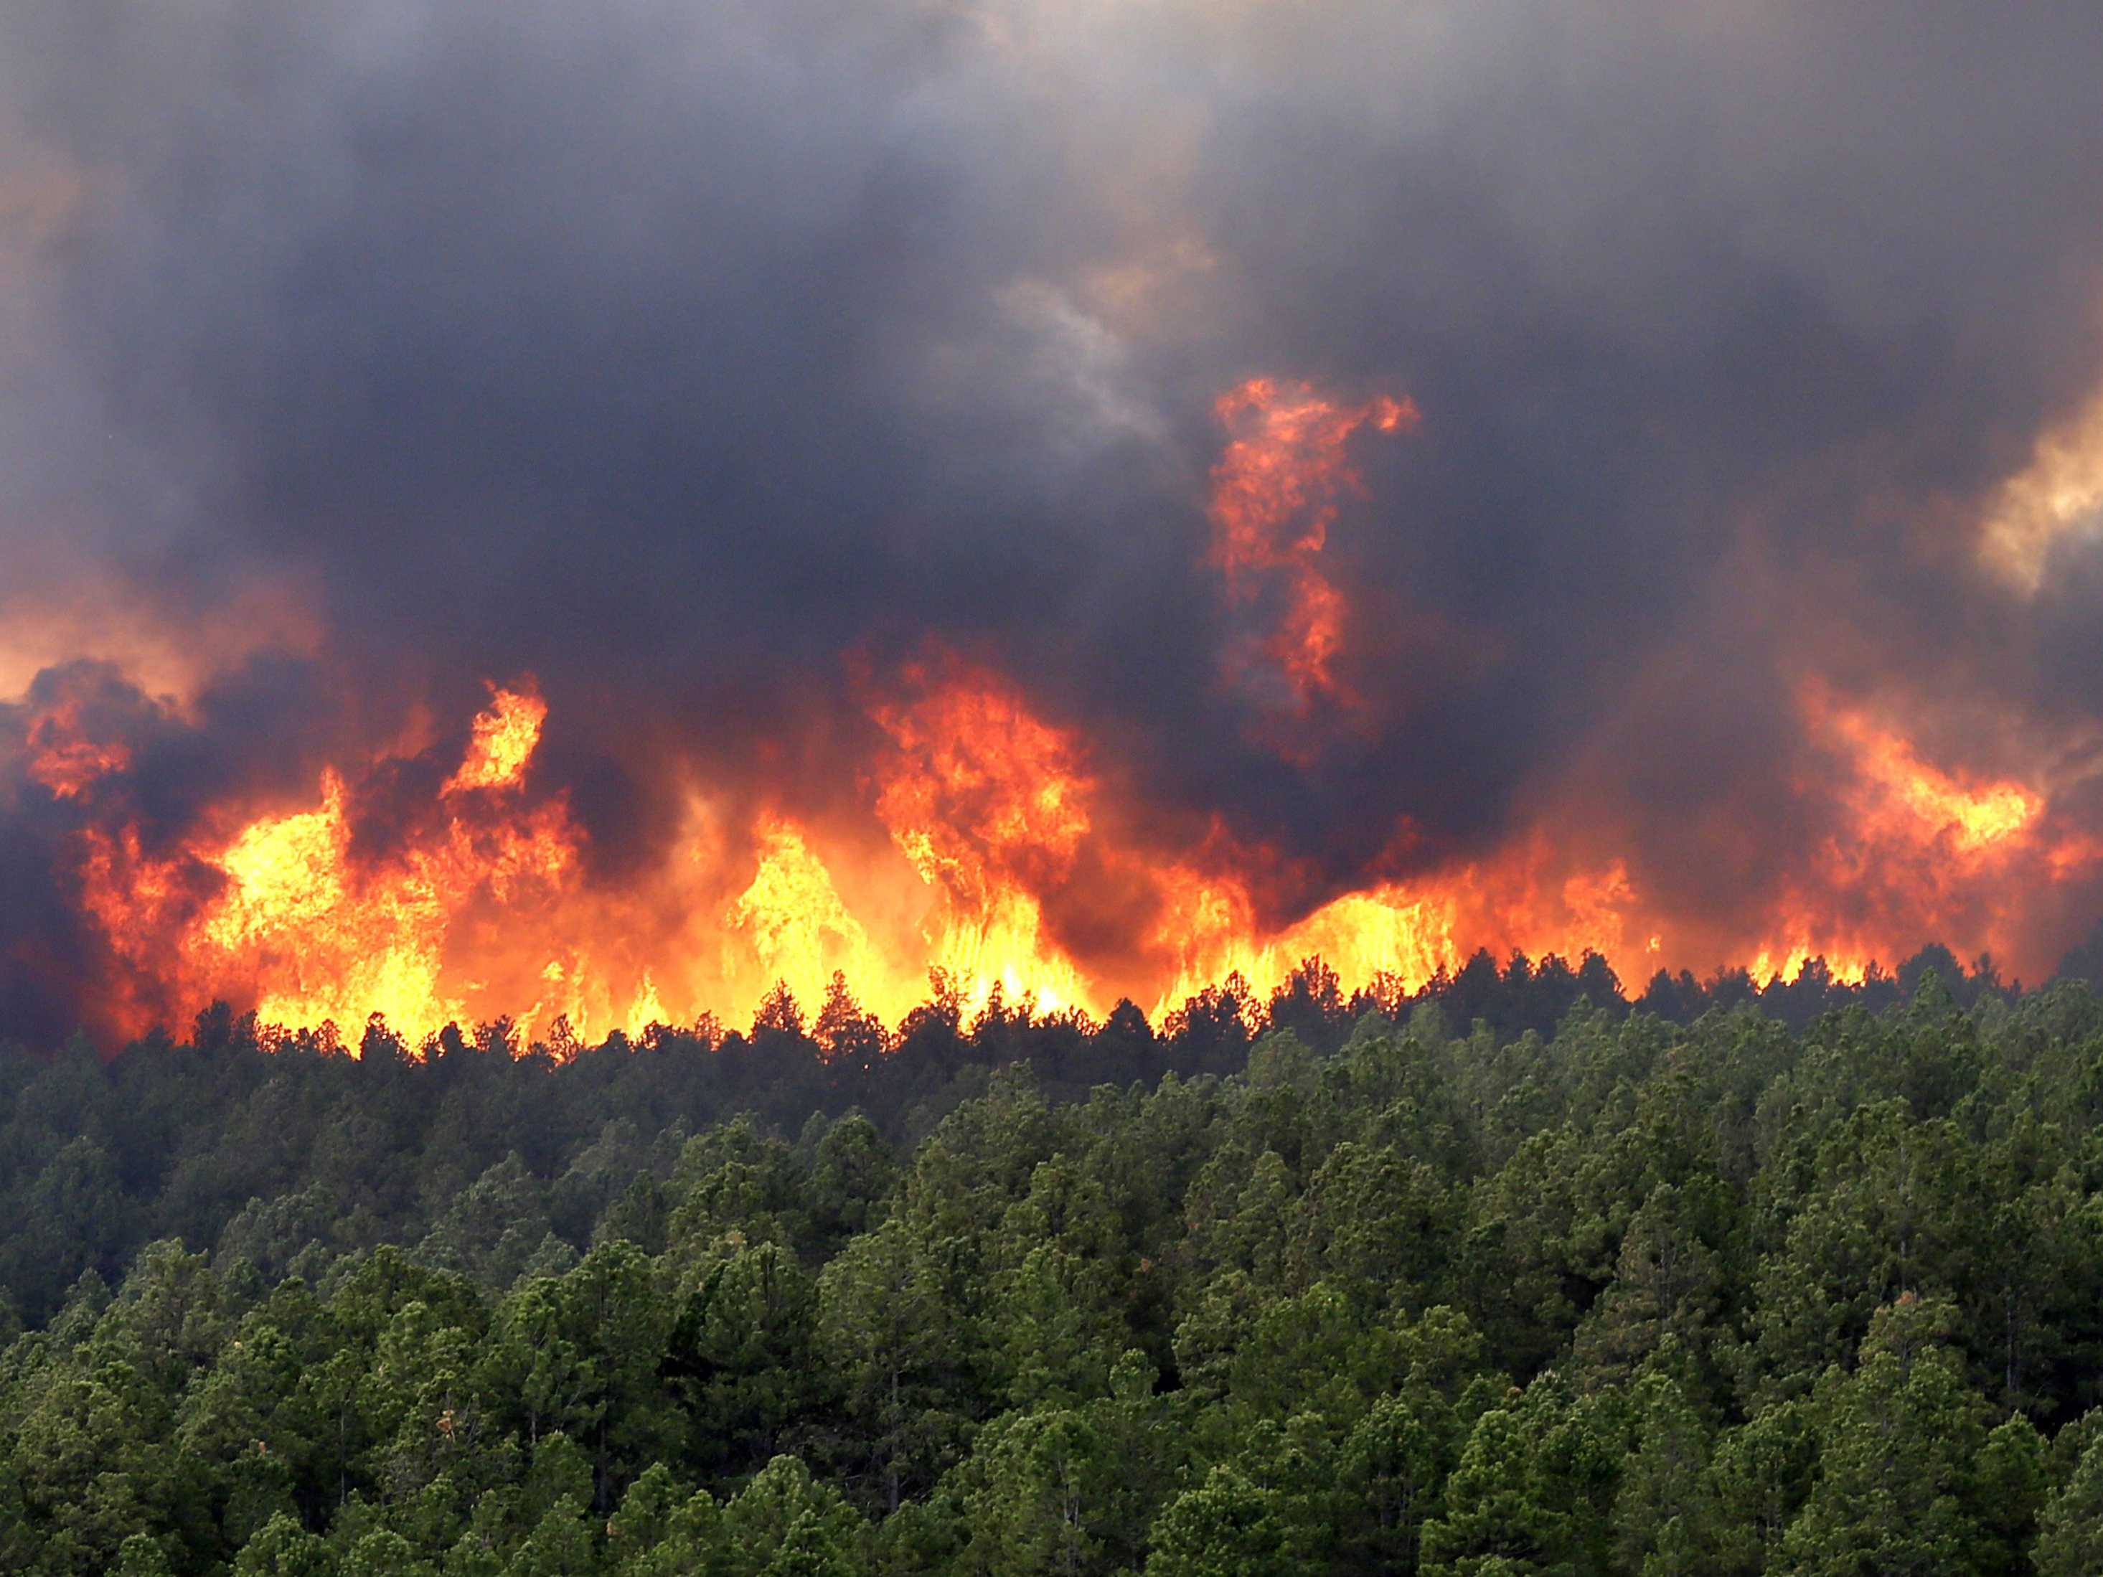
Review Homework

Slide 4
Why Should I Care About Smoke?

Slide 5


What is more important to our health to be clean?
Air
20,000 L/d
Water
1.5 L/d

Slide 6
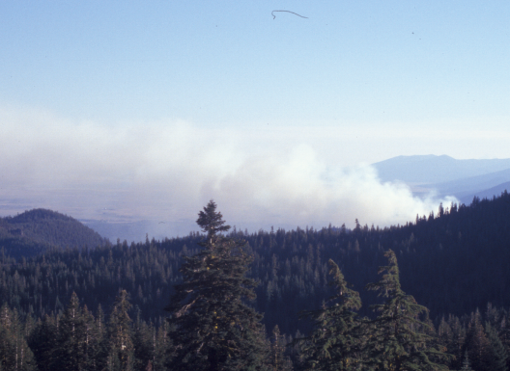
Concerns About Smoke???

Slide 7
Concerns About Smoke
Health: public and firefighters
Safety
Liability
Visibility
Laws and regulations
Nuisance
Social/political
T&E/Wildlife

Slide 8

Fuels and smoke generation

Slide 9
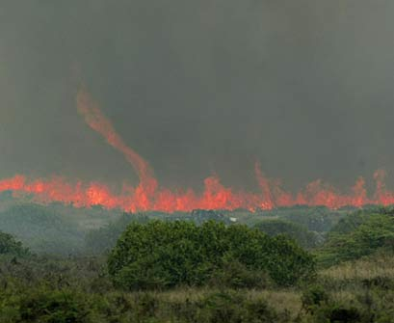
Black Area
Fuel Loading
Largest Error
Second Largest Error
Fuel Consumption
Emission Factor
Smallest Error
Emission Production
Dispersion/Concentration

Slide 10
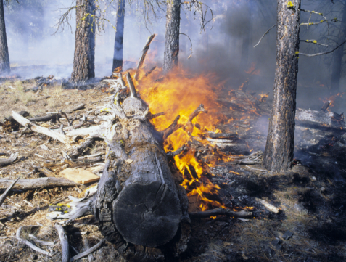
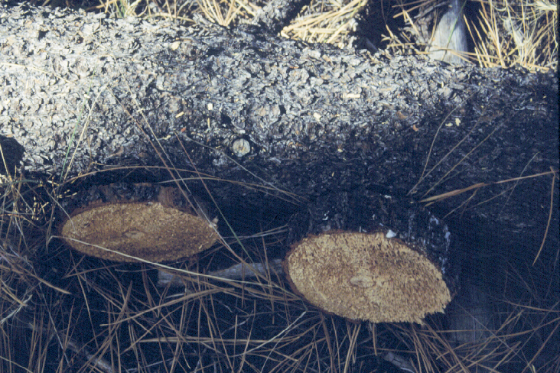
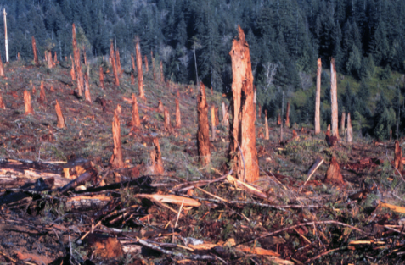
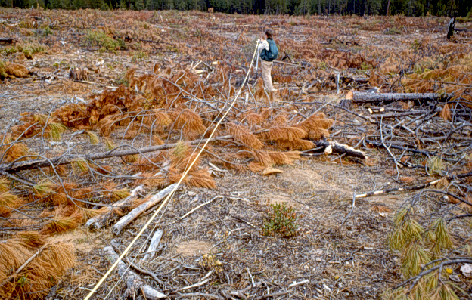
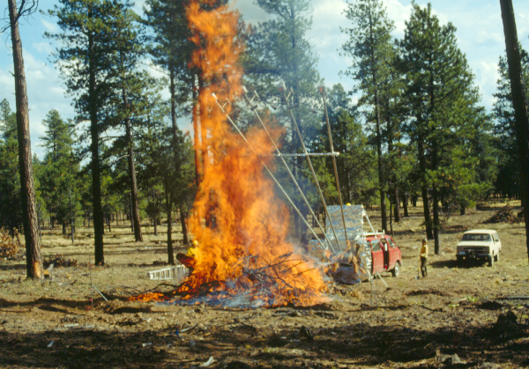
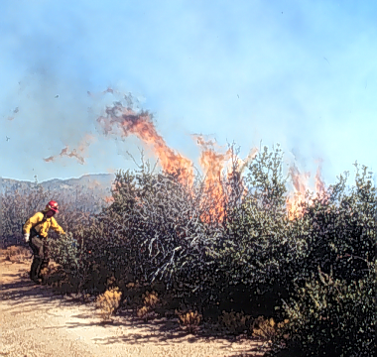
Combustion and Consumption is Affected by Fuel
Loading
Size
Arrangement
Continuity
Fuel Moisture

Slide 11
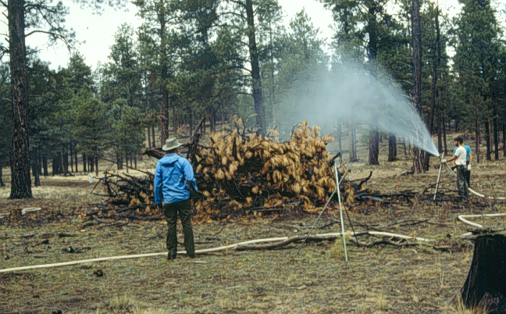
Fuel Moisture Content
Often single most important variable
Live and dead moisture
Increased fuel
moisture will
generally
decrease
consumption

Slide 12
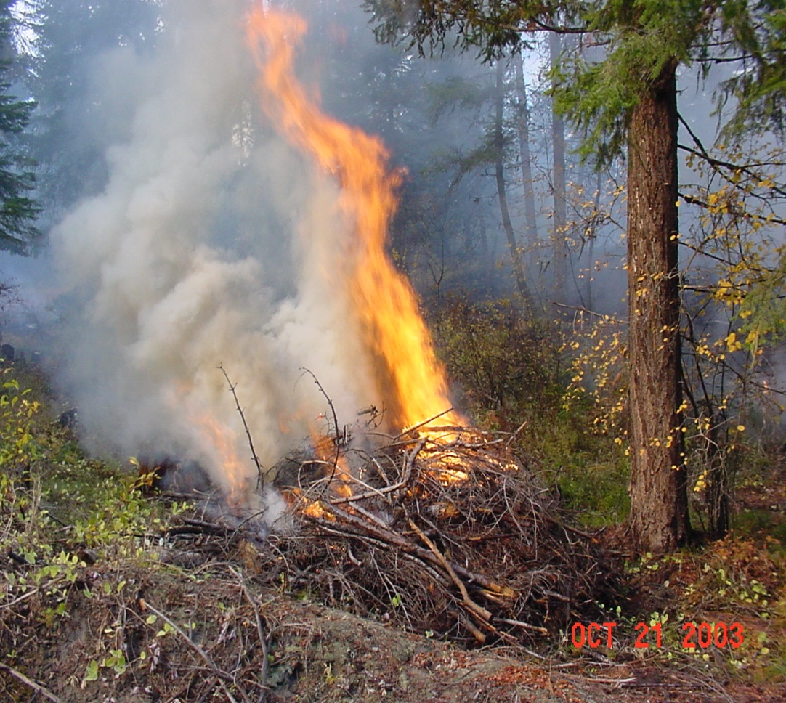
Pre-Ignition Phase
Fuels are heated
Fuel moisture is
driven off and
water vapor
is released
Pyrolysis begins:
thermal
decomposition
of cellulose to combustible vapors

Slide 13
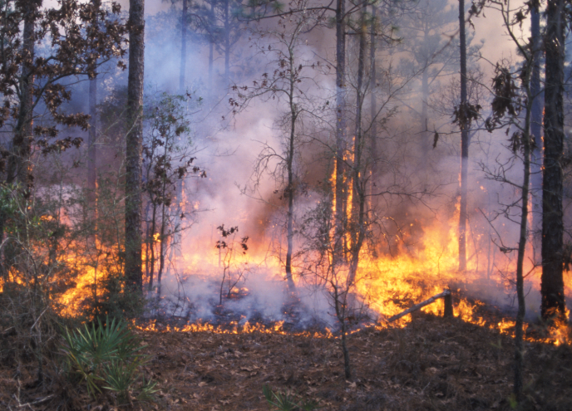
Flaming Phase
Combustible vapors reach 600° F and mix with sufficient oxygen
Accelerates pyrolysis
Rapid oxidation
Produces primarily
CO₂ and H₂O
Partial oxidation
causes a variety
of emissions

Slide 14
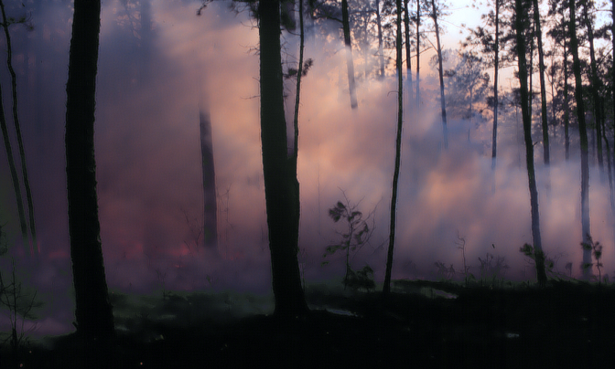
Smoldering Phase
Temperature and
combustible vapor
mixture too low to
support flaming
Temperature drops,
gases condense
Emissions =
2X flaming stage
Insufficient heat
to maintain strong convection column

Slide 15
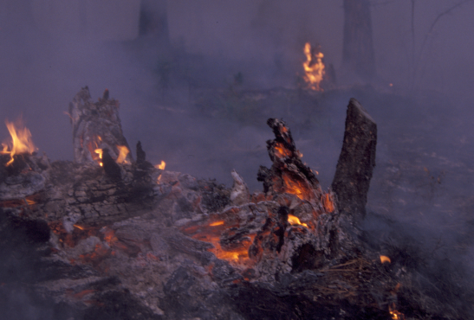
Glowing Phase (Residual)
All volatile gases
driven off
Carbon remaining
No visible smoke
produced
CO₂, CO and ash
primary products

Slide 16
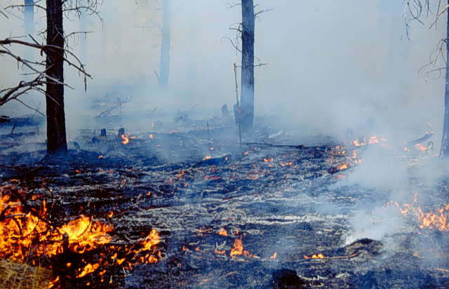
Soot/tar
CO
2
CO
Hot air/gasses
2.5
PM
PM
Glowing (Residual)
Smoldering
Flaming
Pre
-
ignition
RX410-8A-16-EP

Slide 17
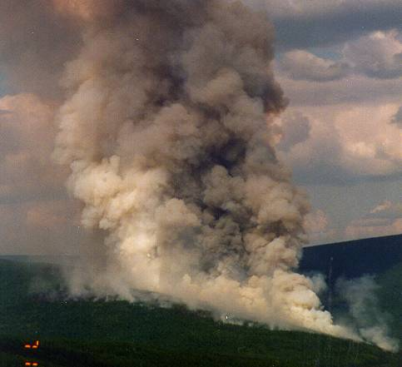
PM/SOOT
Soot, tar, and ash
are the solid “bits”
of particles you can often see formed from chemical reactions in the plume or remnant of flaming combustion.
WATER
Vapors and gases are formed during incomplete combustion and generally cannot be seen.
TAR
ASH
VAPOR
GASES

Slide 18
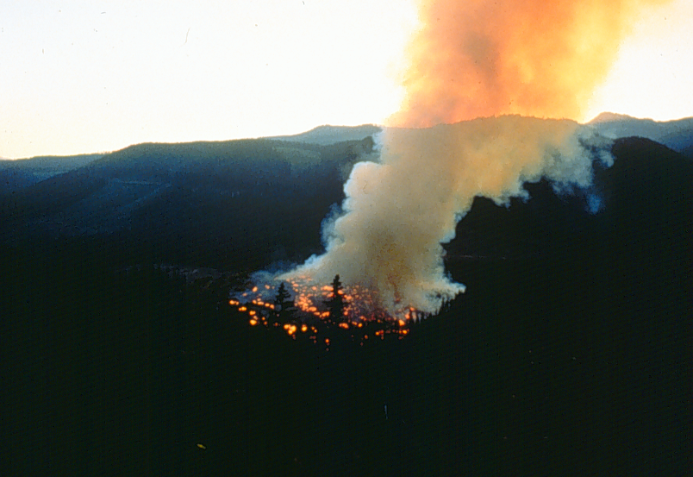
Emissions =
Fuel Consumed x Emission Factor
(tons/acre) (pounds/ton)

Slide 19
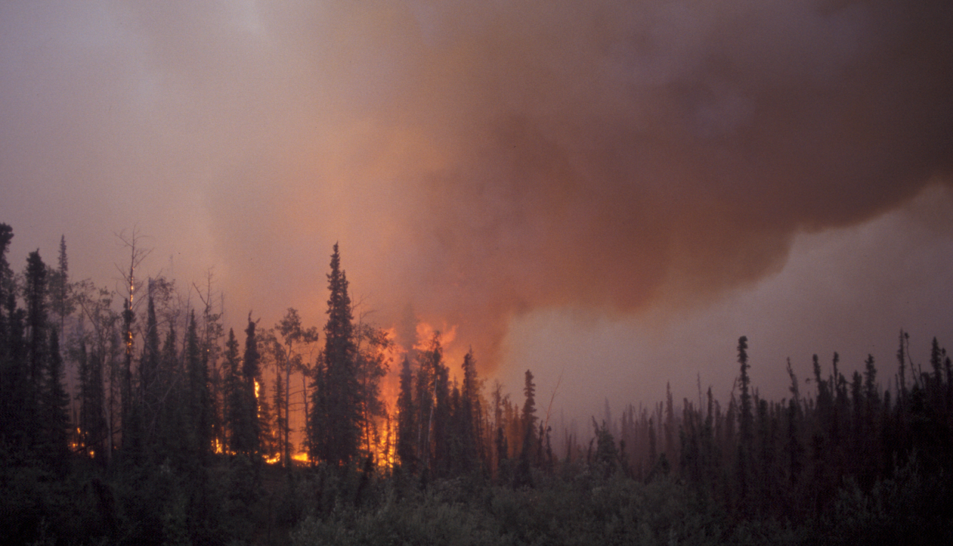
Let’s Review - Products of Combustion
Perfect Combustion
Water vapor (H₂O)
Carbon dioxide (CO₂)
Carbon monoxide (CO)*
Particulate matter (PM)*^{t}
Hydrocarbons (HC) *^{t}
Nitrogen oxide (NOx)*
Secondary emissions (Ozone)*
Primary emissions found in
smoke by mass
* = Criteria Pollutants
^{t} = Air Toxics

Slide 21

Air Quality Regulations

Slide 22
Cleaner air equals 21 more weeks of life
Thu Jan 22, 2009
By Gene Emery
BOSTON (Reuters) - Dramatic improvements in U.S. air quality over the last two decades have added 21 weeks to the life of the average American, researchers reported on Wednesday.

Slide 23
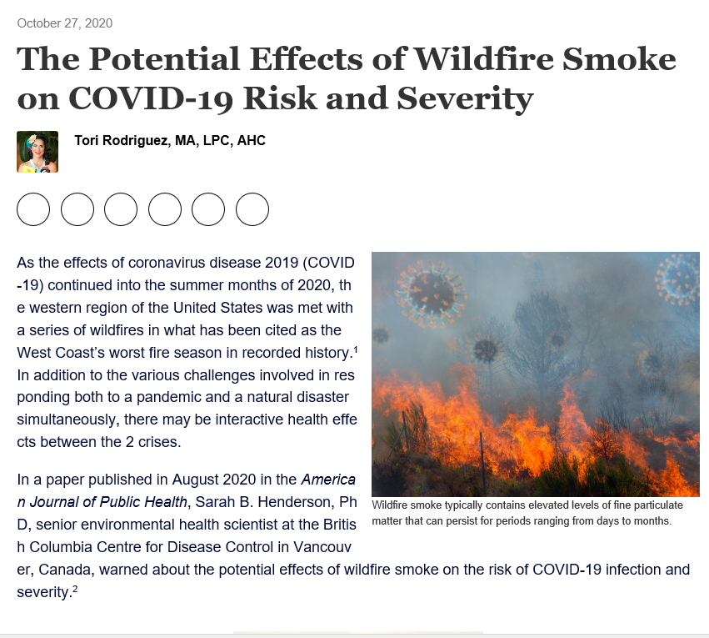
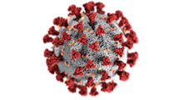
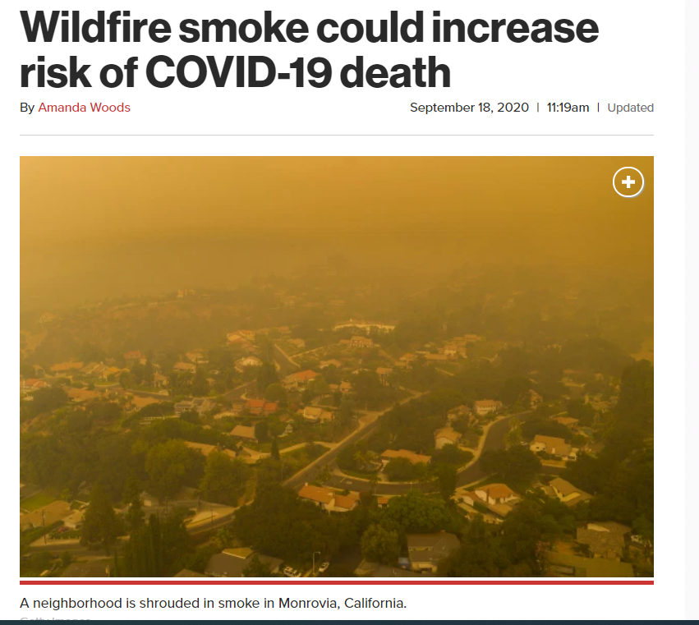

Slide 24
EPA Health Standards
NAAQS - National Ambient Air Quality Standards
Set for the 6 “criteria” or common pollutants:
  Particulate matter (PM_{2.5})
  Ozone (O₃), a secondary pollutant
  Carbon Monoxide (CO), Nitrogen Oxides (NO_{x}), Sulfur Dioxide (SO₂), Lead (Pb)
Reviewed every 5 years
Enforceable
Exceedances can cause a nonattainment designation

Slide 25
Particulate Matter
Smoke particles from wood are relatively small
< PM 2.5 microns
70.0%
10.0%
20.0%
> PM 10 microns
PM 2.5-10 microns
RX410-4-25-EP

Slide 26
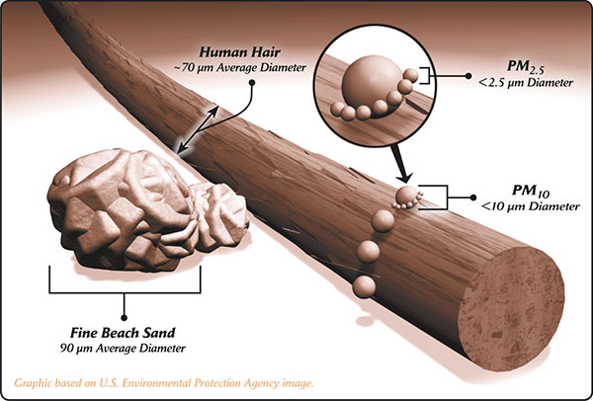
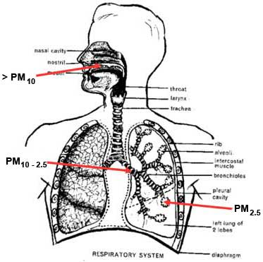
From smoke emission to health effects
Particulate matter

Slide 28
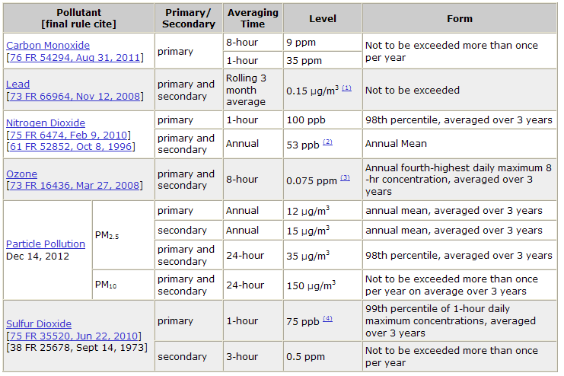
Current NAAQS

Slide 29
Averaging Time
Standards often have multiple values, each with its own averaging time.
PM_{2.5} NAAQS =
  Annual average = 12 µg/m3
  24-hr average = 35 µg/m3
KNOW WHAT AVERAGING TIME YOU ARE TALKING ABOUT!

Slide 30
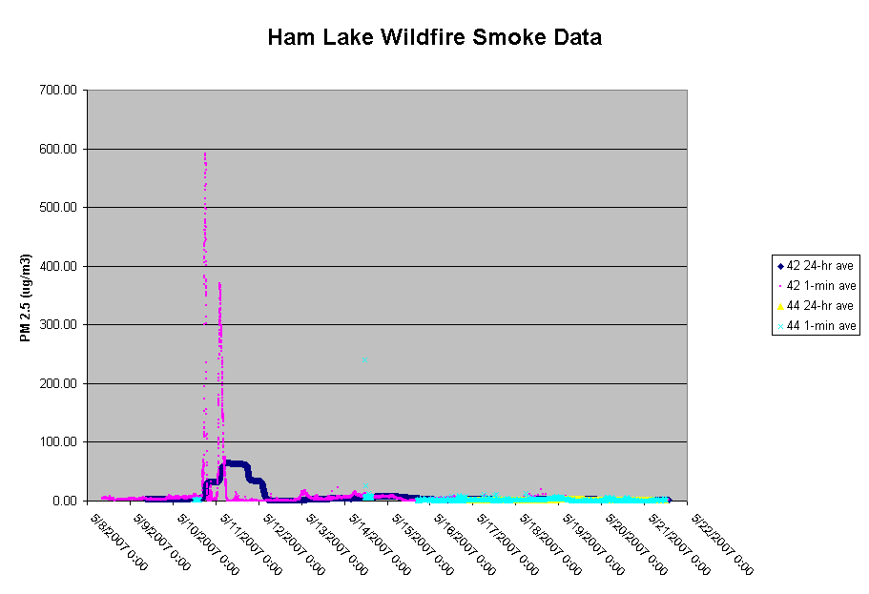

Slide 31
Exceptional Event Rule
EPA can exclude air quality monitoring data from regulatory determinations related to exceedances/violations of the NAAQS and avoid designating an area as nonattainment if a State adequately demonstrates that an exceptional event has caused the exceedance or violation.

Slide 32
Key Points of EER
Rx fire may be considered if we provide documentation to support States:
  Fire activity
  Emissions
  Ecological role of specific event
  Proof of compliance with SMP
  Use of basic smoke management practices

Slide 33
Key Points of EER
  Ecological role of specific event
  What documentation is needed from us?
    FRCC information
    Research on fire ecology for area
    Natural fuels documentation
    Burn not associated with commercial timber operations (clear cut, wind rows, etc.)
    Land/Resource Management Plan, Project NEPA, Burn Plan
    Wildfire versus prescribed fire emissions trade-off

Slide 34
Key Points of EER
Pre-season collaboration/cooperation with the State is essential to prevent exceedances and address a measured exceedance
Follow Basic Smoke Management Practices or state-specific Smoke Management Plans
Keep important documentation for 3 years

Slide 35
What Do I Need to Know About Smoke? (cliff notes version)

Slide 36
What do I need to know about Smoke? (Cliff Notes version)
Your State Smoke Management Plan
  or Basic Smoke Management Practices if you don’t have a plan
What a Nonattainment Area is and why its bad
  and if you burn in/near one
How to figure out how polluted the air is now
How to predict where my smoke will go (or where it went)

Slide 37
What do I need to know about Smoke? (Cliff Notes version)
Your State Smoke Management Plan
  or Basic Smoke Management Practices if you don’t have a plan
What a Nonattainment Area is and why its bad
  and if you burn in/near one
How to figure out how polluted the air is now
LATER How to predict where my smoke will go (or where it went)

Slide 38
States with Smoke Management Plans
Alabama
Georgia
Louisiana
S. Carolina
N. Carolina
Virginia
Arkansas
Florida
Mississippi
Illinois*
Minnesota*
Michigan*
Wisconsin?
* = Region 9

Slide 39
What is the purpose of a SMP?
Minimize smoke entering populated areas (protect public health and sensitive receptors)
Prevent public safety hazards (such as smoke impairment on roadways and runways)
Avoid significant deterioration of air quality and National Ambient Air Quality Standards (NAAQS) violations
Avoid visibility impacts in Class I areas
Process for nuisance mitigation
YOUR PERMIT TO BURN
Notes:
SMP captures all the air quality related regulatory requirements in one document. Takes national regulations and any applicable state/local regs and applies to the local situation. ONE SIZE DOES NOT FIT ALL!!
The regulations protect visibility in Class I areas from man-made visibility impairment. Many Class I Areas have fire-dependent veg types, hence smoke is a component of natural visibility in many class I areas. SMP should discuss this. Can you burn a Class I Area? We burn our Class I area.

Slide 40
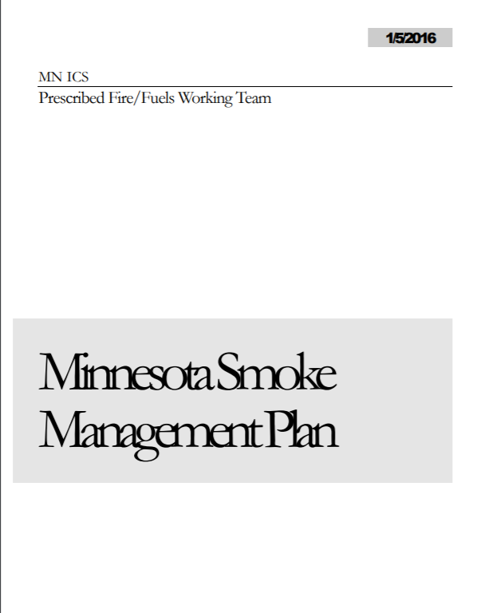
Minnesota
Recently updated
No burn by burn authorization

Slide 41
Sensitive Receptors
Sensitive Receptors—Locations where human population tend to concentrate and where smoke could impact the health of those population or significantly impact visibility that may be detrimental to either health or the enjoyment of scenic qualities of the landscape. These may be residential concentrations in the form of towns or cities, or locations where people tend gather in groups such as parks. Travel routes such as highways may be labeled as sensitive receptor sites where smoke can be a factor in potential motor vehicle accidents. Particular areas along highways or other locations may be more prone to being declared sensitive receptor sites because of topographic and microclimate features.

Slide 42

Sensitive Receptors
Young
Elderly
Those with cardiovascular or respiratory issues

Slide 43
Examples
where smoke and air pollutants can adversely affect public health, safety and welfare
population centers such as towns and villages,
campgrounds and trails,
parks
hospitals,
nursing homes,
schools,
roads,
airports,
Class I areas

Slide 44
4.2 – Burn Plans
4.2.1 Burn Plan Elements
All the organizations burning in Minnesota require prescribed burn plans for each burn. However, if the units are small and the burn objectives and prescription are the same, one plan may cover several burn units. These plans are written following protocols specific to each agency. They will be on file at agency offices and are available upon request. At a minimum, for the purposes of this Smoke Management Plan, these prescribed burn plans must include the following elements:
Location and description of the area to be burned,
Personnel responsible for managing the fire,
Type of vegetation to be burned,
Area (acres) to be burned,
Amount of fuel to be consumed or amount of fuel present on the site (tons/acre),
Fire prescription including smoke management components (see section 4.2.1) and dispersion index,
Criteria the fire manager will use for making burn/no burn decisions,
Safety and contingency plans.

Slide 45
4.2.2 Smoke Management Components of Burn Plans
Actions to Minimize Fire Emissions
  Minimize the area burned
  Reduce the fuel loading in the area to be burned by mechanical means or by using frequent, low intensity burns to gradually reduce fuels.
  Reduce the amount of fuel consumed by burning when fuel moistures for 1000 Hour fuels and duff are high.
  Minimize emissions per ton of fuel consumed by using mass ignition techniques, using backing fires, and performing rapid mop-up.

Slide 46
4.2.2 Smoke Management Components of Burn Plans
Evaluate Smoke Dispersion
Public Notification and Exposure Reduction Procedures
Air Quality Monitoring

Slide 47
4.2.3 - Smoke Management and Dispersion
The Dispersion Index describes the ability of the atmosphere to disperse
emissions and is the product of the mixing height (ft) and transport wind speed (kts).
DI = mixing height x transport wind
TW
MH

Slide 48
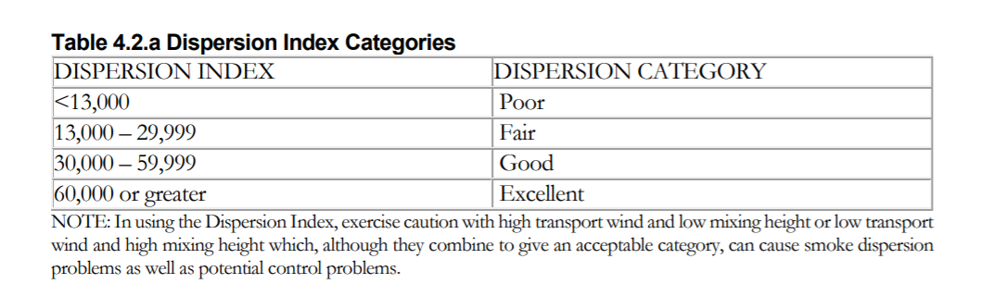
4.2.3 - Smoke Management and Dispersion

Slide 49
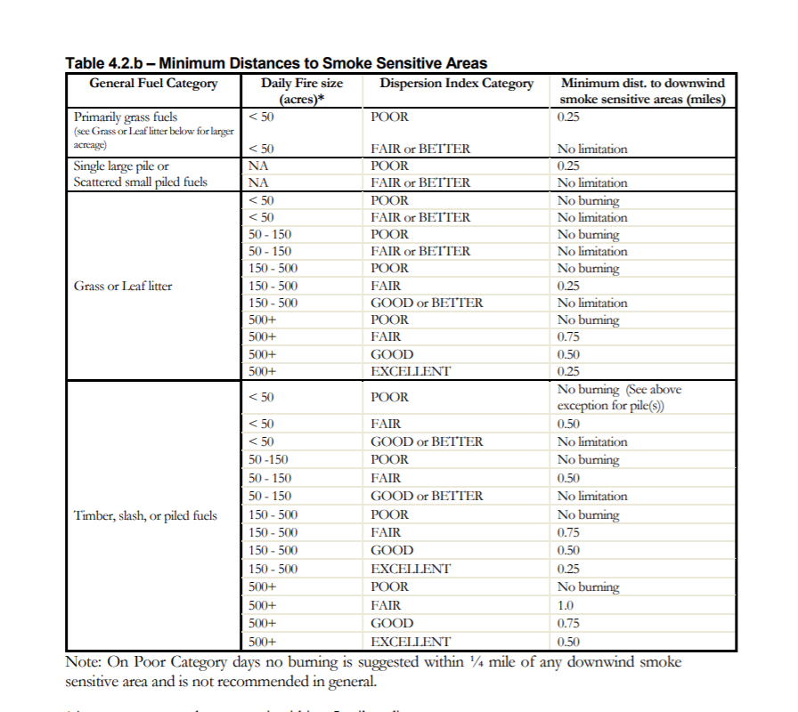
4.2.3 - Smoke Management and Dispersion

Slide 50
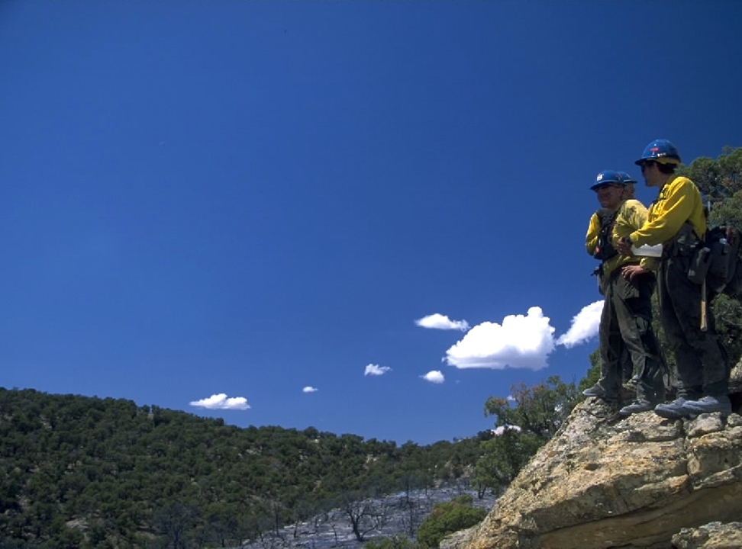
Contingency Plan
In burn plan development, include a contingency plan for unexpected
smoke impacts.
  This should include a communications plan.
12B-50-Rx410-EP
Notes:
VERY important. This is the most overlooked part of the burn plan yet can be the most important. If you get a call in the afternoon that the smoke from your fire is settling into city X, will you know who all to call? Media, schools, elder care facilities, county health dept, etc?? It is best to have thought this out before

Slide 51
What do I need to know about Smoke? (Cliff Notes version)
Your State Smoke Management Plan
  or Basic Smoke Management Practices if you don’t have a plan
What a Nonattainment Area is and why its bad
  and if you burn in/near one
How to figure out how polluted the air is now
LATER How to predict where my smoke will go (or where it went)

Slide 52
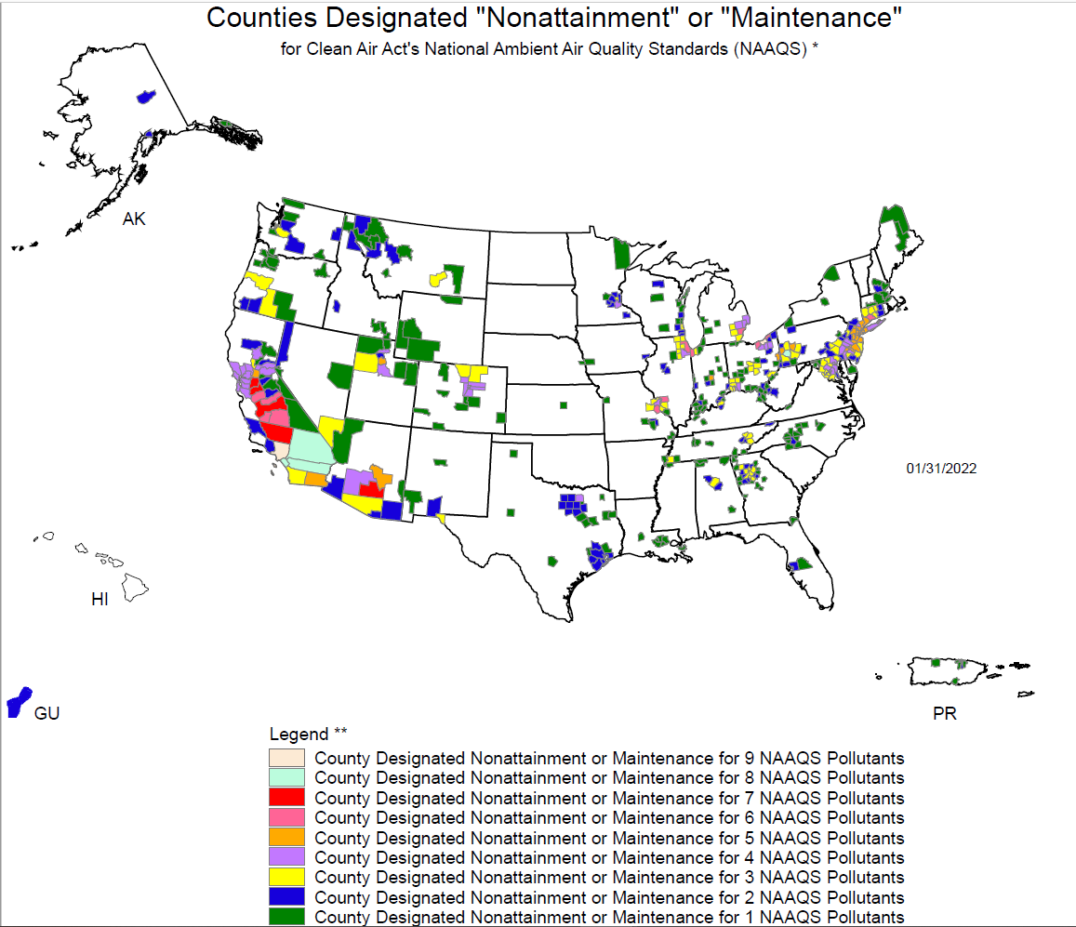

Slide 53
What do I need to know about Smoke? (Cliff Notes version)
Your State Smoke Management Plan
  or Basic Smoke Management Practices if you don’t have a plan
What a Nonattainment Area is and why its bad
  and if you burn in/near one
How to figure out how polluted the air is now
LATER How to predict where my smoke will go (or where it went)

Slide 54
EPA’s Air Quality Index (AQI)
Shorter averaging and reporting times
Compiles information on multiple pollutants into one metric
Uses information from continuous monitoring instruments. Some are not “official”
Used for real time communication with the public – easy to understand format
What you hear about in the news

Slide 55
Index Values | Levels of Health Concern | Cautionary Statements | PM_{2.5} Breakpoints (µg/m³, 24-hr ave)
0 – 50 | Good | None | 0.0 - 12.0
51 – 100 | Moderate | Unusually sensitive people should consider reducing prolonged or heavy exertion outdoors. | 12.1 - 35.4
101 – 150 | Unhealthy for Sensitive Groups | Active children and adults, and people with lung disease, such as asthma, should reduce prolonged or heavy exertion outdoors. | 35.5 - 55.4
151 – 200 | Unhealthy | Active children and adults, and people with lung disease, such as asthma, should avoid prolonged or heavy exertion outdoors. Everyone else, especially children, should reduce prolonged or heavy exertion outdoors. | 55.5 - 150.4
201 – 300 | Very Unhealthy | Active children and adults, and people with lung disease, such as asthma, should avoid all outdoor exertion. Everyone else, especially children, should avoid prolonged or heavy exertion outdoors. | 150.5 - 250.4
301 – 500 | Hazardous | Everyone should avoid all physical activity outdoors | 250.5 - 500
Notes:
The AQI is EPA’s color-coded tool for telling the public how clean or polluted the air is, and steps they
can take to reduce their daily exposure to pollution. The AQI converts concentrations for fine particles to a number on a scale from 0 to 500. The function used to convert from air pollutant concentration to AQI varies by pollutant. If multiple pollutants are measured at a monitoring site, then the largest or "dominant" AQI value is reported for the location.

Slide 56
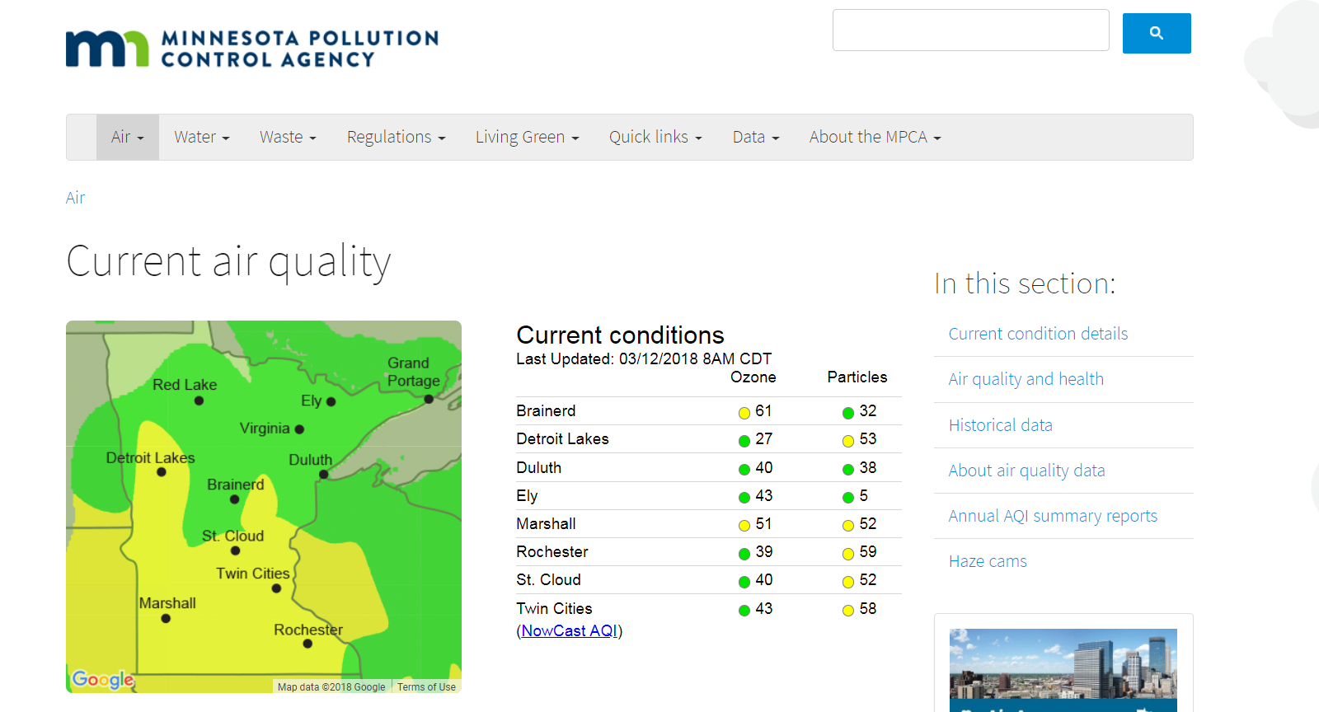
https://www.pca.state.mn.us/air/current-air-quality

Slide 57
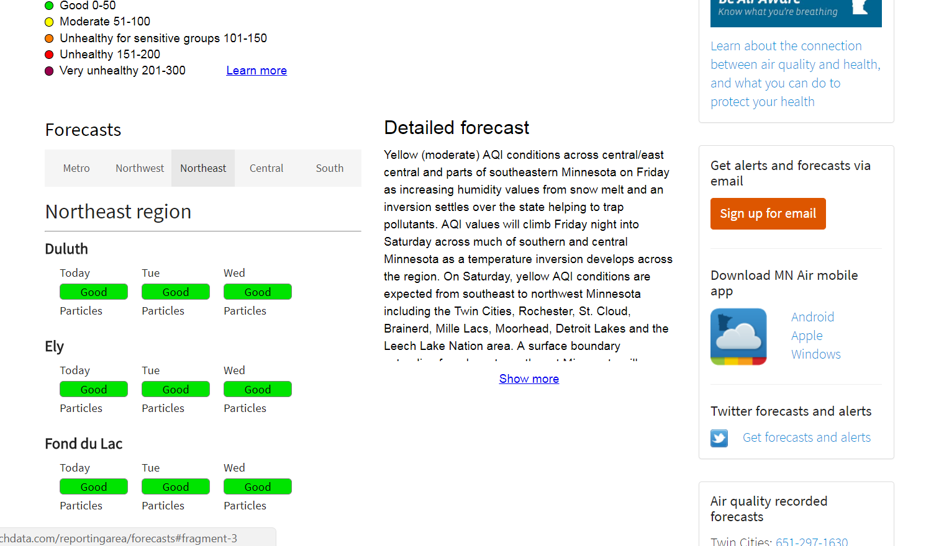

Slide 58
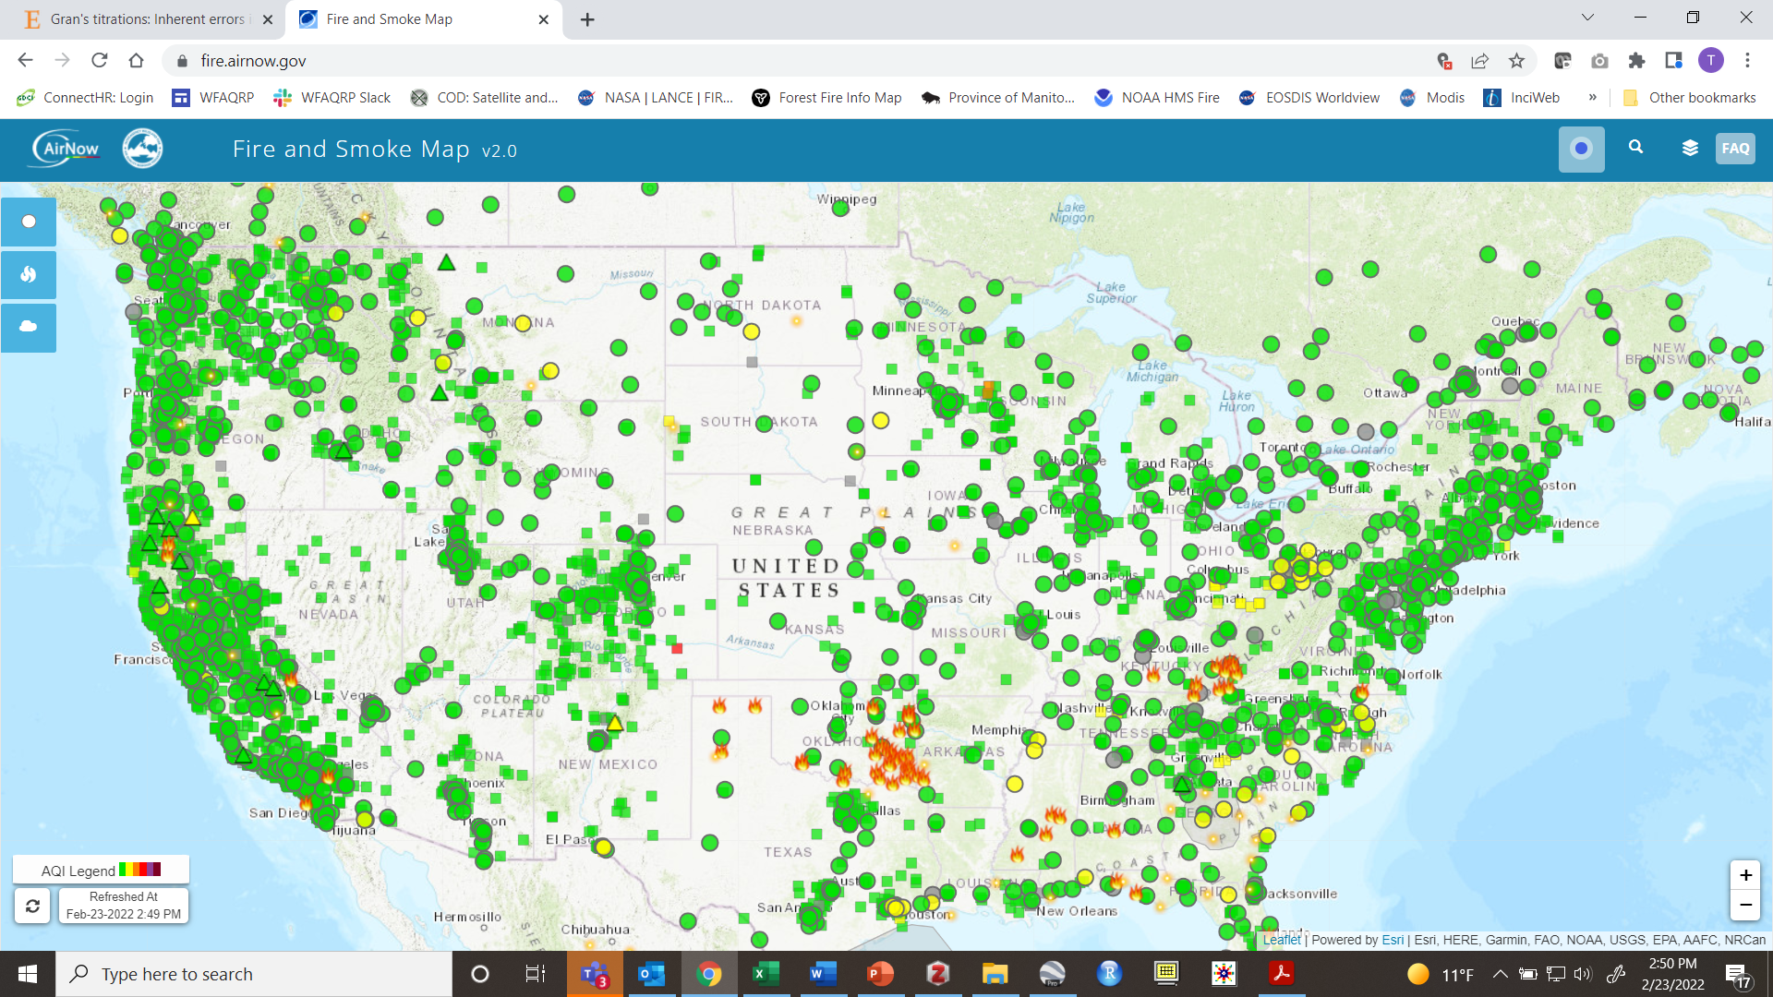
EPA Fire and Smoke Map https://fire.airnow.gov/

Slide 59
BREAK

Slide 60
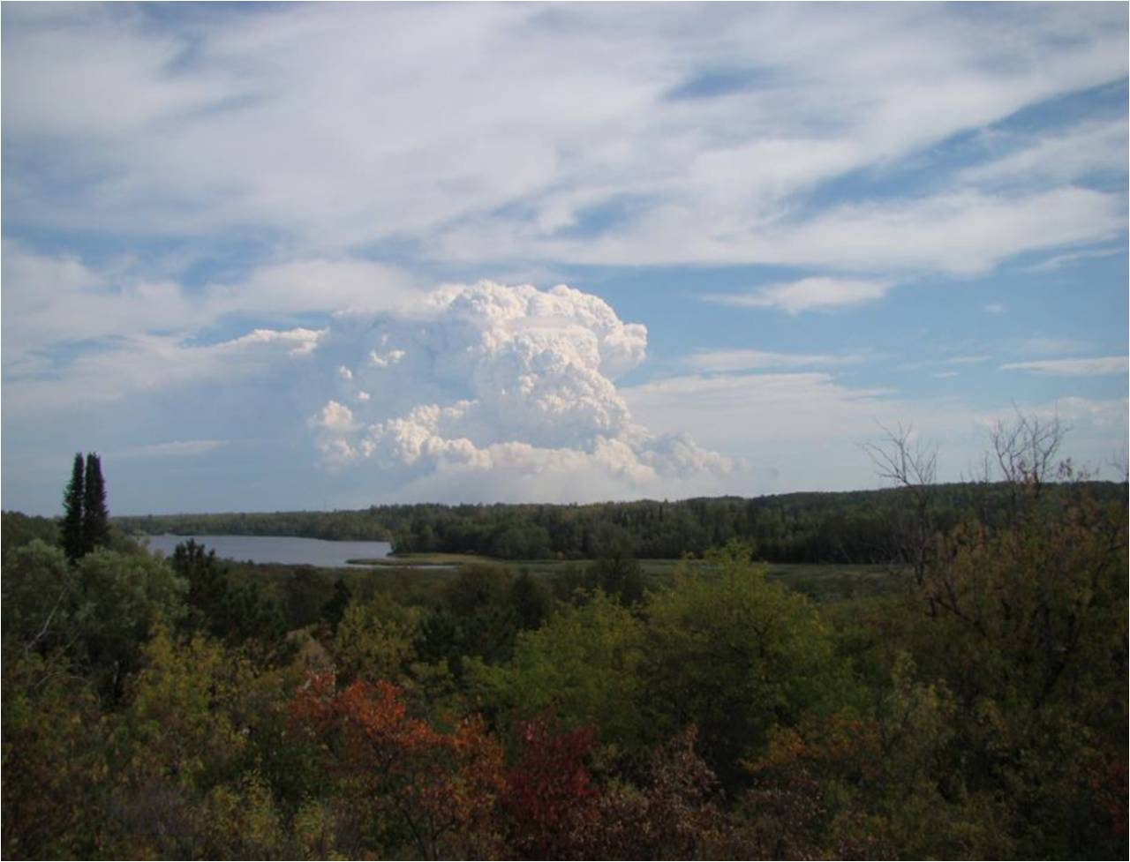


Practical Meteorology
Pagami Creek Wildfire, Sept 12th, 2011.
Photo by Carl Karasti
Amanda Graning and others….
National Weather Service
Duluth, MN
7-60-Rx410-EP

Slide 61
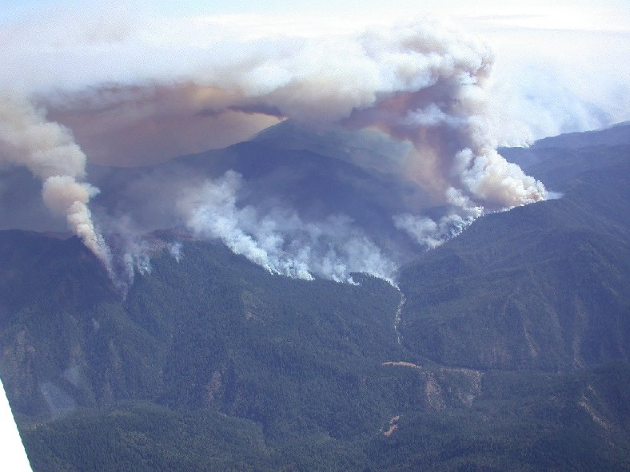
Dispersion Meteorology Terms
Atmospheric Stability
Lapse Rates
Inversions
Lifting Processes
Mixing Heights
Wind & Wind Shear
Dispersion/Ventilation

Slide 62
Quick Weather Basics Review

Slide 63
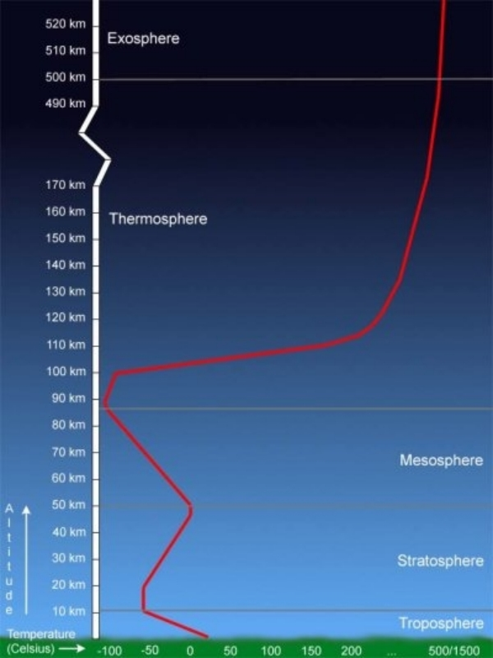
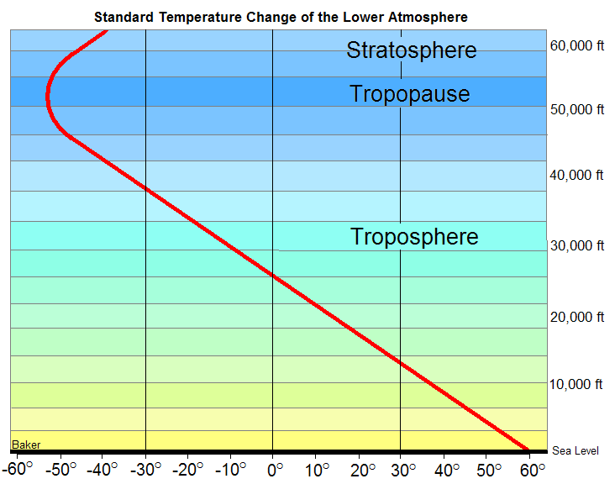
The Troposphere
Atmosphere
Cools with Height

Slide 64


Atmospheric Stability
The degree to which vertical motion in the atmosphere is enhanced or suppressed
Definition:
Air warmer than
surrounding air rises
Air cooler than
surrounding air sinks
7-64-Rx410-EP

Slide 65
Three Types of Stability
Unstable Atmosphere
Stable Atmosphere
Neutral Atmosphere

Slide 66
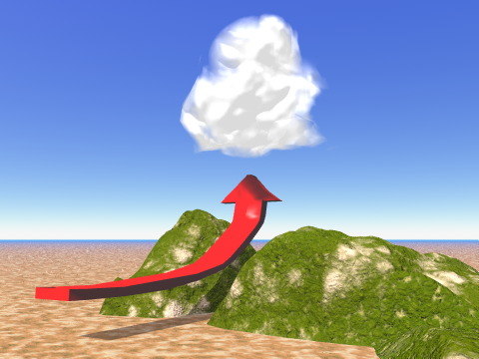
Unstable Atmosphere
  Enhances
  vertical motion
  increases
  mixing
  increases smoke
  dispersion
  helps enhance
  burning
Air parcels
will continue
to rise

Slide 67
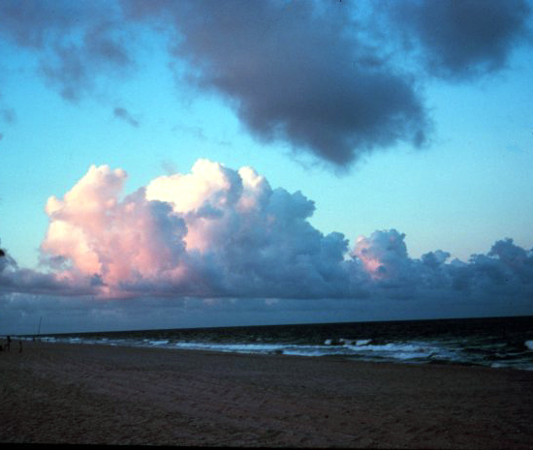
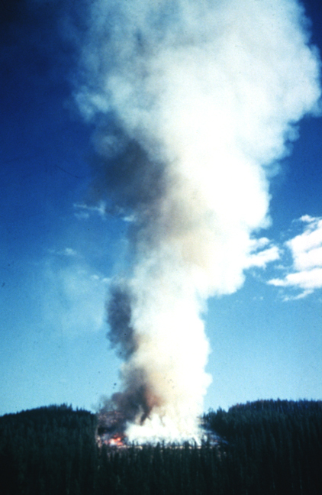
Visual Indicators of Unstable Air
Good visibility
Vertical growth of clouds/Smoke
Cumulus clouds
Gusty winds

Slide 68
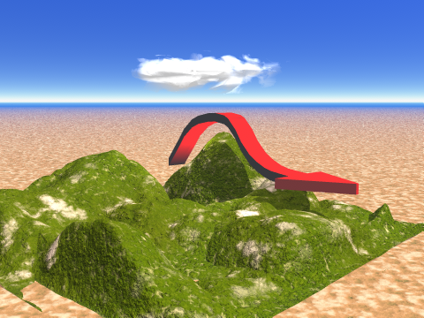
Stable Atmosphere
  suppresses
  vertical motion
  limits mixing
  limits smoke
  dispersion
  may require a
  burn to be
  shut down

Slide 69
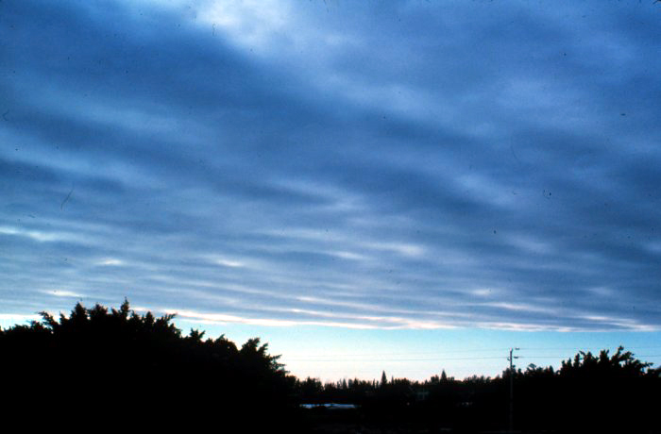
Visual Indicators of Stable Air
Clouds in layers - No vertical motion
Stratus-type clouds
Smoke column drifts apart after limited rise
Poor visibility
in lower levels due to
accumulation of
smoke and haze
Fog
Light and
steady winds

Slide 70

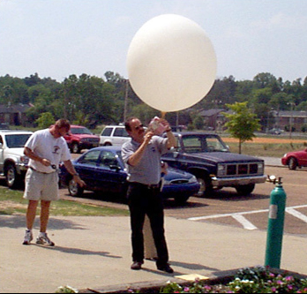
Weather balloons
Released to sample upper level Temperatures and Winds

Slide 71

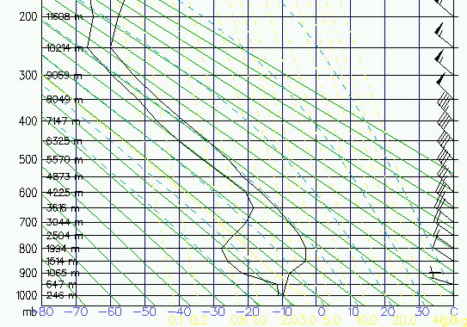
Sounding
Vertical profile of the weather at a point, measured by an instrument called a radiosonde that is released with a weather balloon.
Pressure/Altitude
Cloud Base
Tip: Sounding is a vertical weather map
Temperature
Wind Barbs
Dew Point
Tip: Think vertical weather map!
Temperature

Slide 72
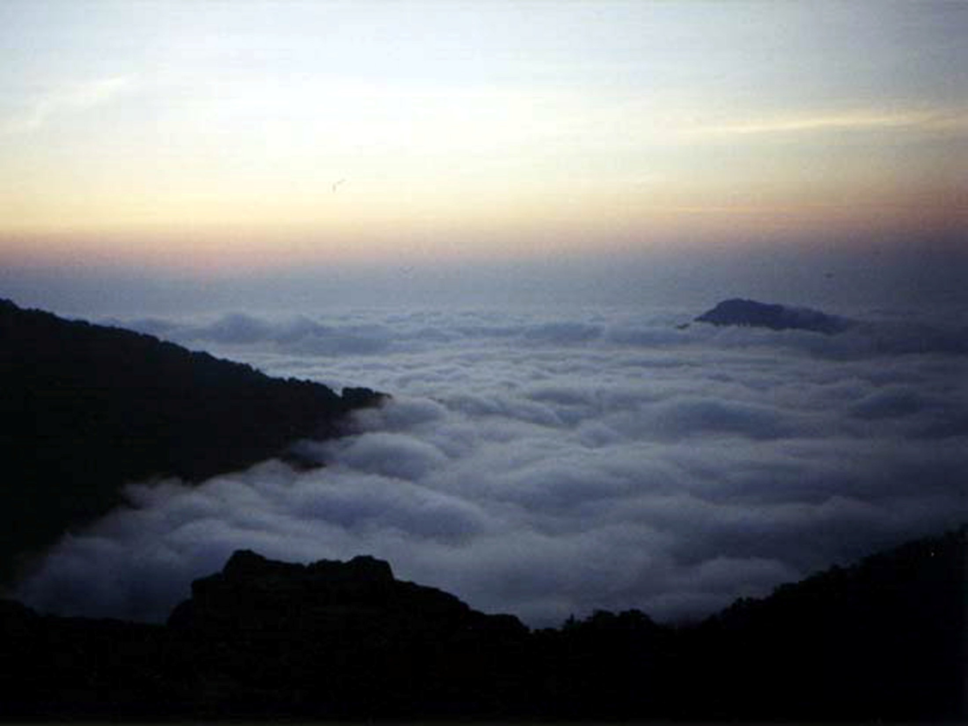
Inversions
7-72-Rx410-EP

Slide 73
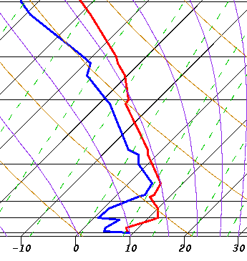
Recall Lapse Rate…..
The change in temperature with increasing altitude
Definition:
Positive
Lapse Rate
Inversion!
Height
Inversion
When temperature increases with increasing altitude.
Temperature

Slide 74

Temperature “Inversion”
Inversions are stable layers which inhibit upward motion and smoke dispersal.
Temperature
Inversion
Altitude
Form when Warm or Cold air is brought into the Area (advection)
Temperature

Slide 75
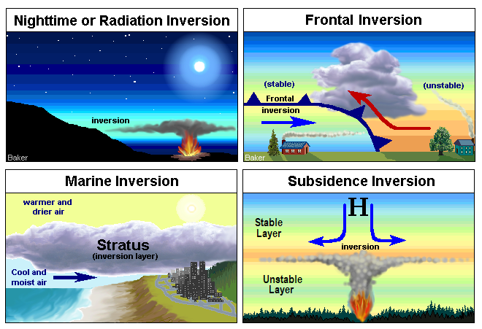
Four Types of Inversions
6-75-S290-EP

Slide 76


Formation of
Nighttime Inversion
Late afternoon
Evening
Overnight
Ground radiates
heat
Sun heats the ground
Altitude
INVERSION

Slide 77

Dissipation of
Nighttime Inversion
Sunrise
Mid morning
Noon time
Ground Absorbs
Heat
Altitude
INVERSION

Slide 78

Mixing
Definition:
Mixing is a process of upward and downward mixing of a layer of air.
Mixing Height
Definition:
The height above ground through mixing occurs. i.e inversion height

Slide 79
Mixing Height
Dry Lapse Rate
Ambient air profile
or sounding
Altitude
Mixing Height Varies Through the Day
Mixing height
Mixing
layer
Temperature

Slide 80

Evolution of the
Daytime
Mixing Layer
12,000 Ft AGL
Maximum Mixing Height
2 PM
2 PM
7400 Ft AGL
Noon
Noon
2800 FT AGL
10 AM
10 AM
1500 Ft AGL
8 AM
8 AM
58F
G r o u n d
55ºF
63ºF
75ºF
80ºF
88ºF
6-80-S290-EP

Slide 81

Seasonal Variation in the Height of the Mixing Layer
Average depth of the Mixing Layer
The wildfire is at 2,500 feet ASL.
The depth of the mixing layer varies considerably during the year.

Slide 82

Visual Indicators
Low Mixing Height means that
smoke concentrates at low levels

Slide 83
Transport Winds
Definition:
Average Winds (direction and speed) in the Mixed Layer; represent net effect of winds that work to move smoke
Altitude
Temperature
Direction Speed
310 @ 40
330 @ 25
270 @ 10
250 @ 15
230 @ 10
Average = Transport Winds
Mixing
layer
250 @ 12
Temperature

Slide 84

The stronger the winds
The better the dispersion

Slide 85

Dispersion
Unstable lapse rate (looping)
Stable lapse rate (coning)

Slide 86


Weather and Smoke
Management Forecasts

Slide 87


Weather and Smoke Mgmt Forecasts.
www.Weather.gov
NWS general, spot and point forecasts provide operational weather information.

Slide 88

NWS Spot Forecasts
Hysplit??
Notes:
All values are automatically generated from the forecast graphics…..recall downfalls of derived hrly temps and wind gusts values...
Can not “Create-and-send” Requires refining by forecaster.

Slide 89


Smoke Management Forecasts
All NWS offices forecast :
1) Mixing Height
2) Transport Wind
3) Ventilation (dispersion)
4) Haines Index
Text, Graphical and Hourly Forecasts

Slide 90


Hourly Forecast
for a specific point
Fire Weather Dashboard (Poker)
https://www.weather.gov/dlh/fwd

Slide 91
LUNCH

Slide 92
Smoke
Tools

Slide 93
Tool #1) Using Wind Roses to Assess Tradeoffs with Wind Direction Windows

Slide 94
Tool #2) Using Forecast Soundings to Get a Better Picture of the Smoke Rise and Transport at Your Location

Slide 95
Tool #3) Using Trajectories to Determine Smoke Transport and Culpability for a Smoke Event

Slide 96
Trajectory Models
Model that uses archived and/or predicted meteorological info to calculate where air came from (back trajectory) or traveled to (forward trajectory) based on a starting location, height and time.

Slide 97

Smoke in Minneapolis: Sept 9, 2011
Back trajectory

Slide 98
What it does NOT do
HYSPLIT trajectory model does NOT produce concentration estimates of smoke.
…meaning it does NOT tell you how MUCH smoke is in the air
…it just tells you WHERE the smoke is going or where it has been

Slide 99
Key Inputs
Where – Location of fire (smoke)
  X,Y not as important as height AGL (plume rise)
When – when will smoke be generated at a significant height?
Try to bracket possible combinations of conditions (perform multiple runs)

Slide 100

Chicago Smoke Sept 13, 2011
1700 arrival @ 100 and 1000 m AGL
Noon arrival @ 100 and 1000 m AGL

Slide 101
Key Issues
Accuracy – model uses gridded meteorological data. Some are 12 x 12 km cells
Not useful for near-field impacts (use spot forecasts of surface and transport wind directions)
A useful tool when used correctly by someone who understands its limitations

Slide 103
Black Area
Fuel Loading
Largest Error
Second Largest Error
Fuel Consumption
Emission Factor
Smallest Error
Emission Production
Dispersion/Concentration

Slide 104
Tool # 4) and 5) Dispersion Modeling using Simple Screening and VSMOKE

Slide 107
Smoke Monitoring – from photos to monitors
Why Monitor?

Slide 108
Reasons to Monitor
Evaluate impacts on communities
Provide feedback to public, regulators, smoke forecasters, and managers.
Verify assumptions and predictions in analysis documents
Avoid violations of air quality standards.
Assess visibility in Class I areas.

Slide 109
Reasons to Monitor (cont.)
Wildfire/prescribed fire tradeoffs
Demonstrate we are good neighbors
Establish nuisance thresholds
Distinguish our impacts from others
Verification of predictions from smoke models

Slide 110


Particulate
Monitoring Equipment
Gravimetric
  Filter based; weighs mass
  Labor intensive
  Need line power
  Location semi-permanent
  Very accurate but slow data return
  Not typically used for smoke

Slide 111
Particulate
Monitoring Equipment
Optical
  Measures light scattering or
  light absorption
  Converts to concentrations
  Real-time data
  Portable
  Relatively inexpensive
  Less accurate than gravimetric
  Used for smoke
PM2.5
E-Sampler

Slide 112
Particulate
Monitoring Equipment
Beta Attenuation Monitors (BAM)
  Collect particulate on a tape
  Radiation is directed across the tape at a sensor
  Tend to be the ones used to produce AQI information
  Smaller version used for smoke
E-BAM

Slide 113

Cameras
Can incorporate photos with distance markers to gather quantitative data

Slide 114


Slide 115

Satellite
Issues
Minimum fire size
Cloud cover
Timing of satellite pass

Slide 116
Where to Monitor
Sensitive locations
  Schools, day care
  Hospitals, nursing homes
  County fairs
Placed away from local pollution sources
  Dirt roads
  Wood stoves
  Traffic
Access to Line Power?
Permission – private property?

Slide 117
When to Monitor
Depends on objectives
  Project impact monitoring
    May be hourly for several days before and after project
  Permanent network operates year round
    NAAQS monitoring
      Once every six days
    Visibility monitoring
      Every third day

Slide 118

Nearby Air monitors = FREE data

Slide 120
Trent’s Smoke Management Program Tips
Establish and maintain relationships with key state air quality folks
Implement an ongoing program to educate the public in likely impacted areas,
  To gain their support for your burning program
  So at-risk folks will remove themselves from dangerous situations
Take existing air quality into account (AQI)
Know your SMP-BSMP/state air regs/procedures
ALWAYS FOLLOW THEM!!
Notes:
Don’t want your first introductions to be at an enforcement mtg with the lawyers etc. Invite them out to a burn
Focus message to at-risk populations, young, elderly, cardio/respir conditions
This can’t be our only measure of success/failure – new NAAQS ½ of old
We can’t ignore existing AQ when making go/no-go decisions
If you light up an FRM you better have followed procedure

Slide 121

http://lakestatesfiresci.net

Slide 122
Questions?
Feel free to contact me with additional questions

Slide 123
EXTRAS

Slide 124
State - Air Monitoring Data
https://www.pca.state.mn.us/air/air-monitoring-network-plan
https://dnr.wisconsin.gov/sites/default/files/topic/AirQuality/2022AnnualNetworkPlan0629.pdf
http://169.62.82.226/documents/egle/ambient-monitoring-network-review-2021-07-01_729037_7.pdf

Slide 125
Basic Smoke Management Practices
Evaluate Smoke Dispersion Conditions
Monitor Effects on Air Quality
Record-keeping/Maintain a Burn/Smoke Journal
Communication – Public Notification
Consider Emission Reduction Techniques
Share the Airshed – Coordination of Area Burning
These are good practices to consider whether or not your state has a smoke management plan!

Slide 126
BSMP1: Evaluate smoke dispersion conditions
Before
  Identify smoke sensitive areas
  Identify meteorological conditions
During
  (critical) Obtain latest meteorological forecast
  Obtain AQ conditions (AIRNOW) or state/local
  Verify forecast with observations (RAWS or other)
After, burn operations
  Assess smoldering conditions
Notes:
to minimize smoke impacts

Slide 127

BSMP2: Monitor the effects on air quality
Monitoring effects of fire on air quality
  Where does the smoke go?
  How high does it go?
  Does the smoke disperse or is tight and dense?
Methods – Visual monitoring documented by:
  notes, photographs, aircraft observations, satellite imagery, air quality monitoring data, and post-burn evaluations.
Note air quality near sensitive receptors
US Forest Service Smoke Photo Series
Notes:
Monitor the effects of the fire on air quality

Slide 128

BSMP3: Record-keeping
Keep a personal burn/smoke journal
What records to keep?
  Weather (forecasted and observed)
  BSMPs applied
  Fire activity (location, area burned, date, ignition time, etc.)
  Fuels burned and acreage
  Smoke behavior & impacts (if any)
Assess conditions and burns that meet goals, and provide lessons learned
Documentation can be key if there is an air quality exceedance and the state seeks to exclude the data. This can be years later.

Slide 129

BSMP 4: Communication – Public Notification
Notify appropriate authorities (e.g., air regulators, public health officials, local fire department)
Notify those in the public potentially affected by the smoke
If an impact occurs, prepare contingency actions to reduce exposure (e.g., mop-up, reducing area burned)

Slide 130

BSMP5: Consider use of emission reduction techniques (ERTs)
Ensure objectives are not compromised as ERT’s are site specific
ERTs can include:
  reducing fuel burned
  increasing burning efficiency
NRCS Practices considered ERTs: Brush Management, Clearing and Snagging, Firebreak, Forest Stand Improvement, Fuel Break, Prescribed Grazing, and Woody Residue Treatment.

Slide 131

BSMP6: Share the Airshed – Coordination of Area Burning
Communication among fire managers burning in the same vicinity on the same day
Coordinate and plan ignitions so as not to overwhelm the ability of the atmosphere to disperse the smoke
Current smoke/AQ information
  AIRNOW (http://www.airnow.gov) or from local/state air quality monitoring networks.
  NOAA Hazard Mapping System – current satellite fire detections (http://www.ospo.noaa.gov/Products/land/hms.html )

Slide 132
Basic Smoke Management Practices
Meteorological scheduling and smoke impact evaluation (critical)
Monitoring effects of the fire on air quality and document smoke dispersion (critical)
Track fire activity on a daily basis
Document the event and retain relevant records for 3.5 years
Share the airshed
Public notification (critical)
Exposure reduction (critical)
Apply emission reduction techniques (ERTs)
http://www.frames.gov/partner-sites/emissions-and-smoke/educational-resources/tutorial/lesson-3/
Notes:
Don’t use this slide, use other slide

